Slide 1


22CSP72 – PROJECT WORK II PHASE I
An Agentic Vision-Language Framework for Explainable Oral Cancer Screening using Evidence Verification and Confidence-Aware Clinical Reasoning
DONE BY,
23CSR149 NITHEESH S
23CSR174 REDHANI T V
23CSR184 SABARISH K S
SUPERVISED BY,
Ms.D.NANTHIYA, AP(SRC)
1

Slide 2
PROBLEM DEFINITION
Oral cancer is often diagnosed at advanced stages, resulting in high morbidity and mortality rates.
Current diagnosis relies on biopsy and expert histopathological examination, making the process invasive, time-consuming, and costly.
There is a shortage of specialized oral pathologists, particularly in rural and low-resource regions.
Existing deep learning models function as black-box systems and do not provide transparent clinical reasoning or evidence verification.
Current AI systems lack knowledge grounding, confidence estimation, and clinician-friendly explanations, reducing trust and real-world adoption.
2

Slide 3
LITERATURE SURVEY
Paper | Summary | Research Gap
Explainable label guided lightweight network with axial transformer encoder for early detection of oral cancer (BASE PAPER) | Developed a lightweight CNN-Transformer model (LWENet) with Grad-CAM for accurate and interpretable oral cancer classification. | Limited to classification; lacks lesion segmentation, medical knowledge retrieval, and explainable multi-agent clinical reasoning.
Guan et al. (2025) – Multi-OSCC Histopathology Dataset | Introduced a large-scale benchmark dataset with 1325 OSCC patients for diagnosis and prognosis research. | Provides dataset only; no explainable diagnostic framework.
Multi-Agent Systems for Clinical Decision Support: A Systematic Review (2025) | Reviewed multi-agent AI systems for healthcare decision support and diagnostic reasoning. | Not specifically designed for oral lesion imaging or oral cancer screening.

Slide 4
LITERATURE SURVEY
Paper | Summary | Research Gap
Warin & Suebnukarn (2024) – Deep Learning in Oral Cancer: A Systematic Review | Reviewed 54 studies on deep learning applications for oral cancer detection, classification, segmentation, and prognosis. | No explainable AI, no agentic framework, no confidence-aware reasoning.
Dutta et al. (2024) – Oral Cancer Classification Using Hybrid Attention-Aided Deep Learning Model | Used EfficientNetB0 with hybrid attention mechanisms to improve feature extraction and oral cancer classification. | Focuses only on classification; lacks clinical reasoning and evidence verification.
Deep Learning for Early Diagnosis of Oral Cancer via Smartphone/DSLR Images (2024) | Evaluated deep learning models on smartphone and DSLR oral images for early screening. | No literature grounding, no multi-agent decision-making framework.

Slide 5
LITERATURE SURVEY
Paper | Summary | Research Gap
Early Oral Cancer Detection with AI: Deep Learning Image-Based Chatbot (2025) | Combined CNN, Class Activation Mapping, and chatbot-based interaction for patient assistance. | Chatbot responses are not evidence-verified and lack medical knowledge retrieval.
Performance Evaluation of Oral Cancer Detection and Classification Using Deep Learning (2022) | Combined clinical information and imaging features using optimized CNN architecture. | Limited interpretability and no evidence validation mechanism.
Oral Cancer Detection Using Deep Learning Techniques (2023) | Applied deep learning to oral cytology and brush biopsy images for detection. | Limited focus on image classification; lacks confidence estimation.

Slide 6
RESEARCH GAPS IDENTIFIED
After reviewing previous studies, the following gaps were identified:
No existing work combines oral lesion analysis with Vision-Language Models and Medical RAG.
Existing AI systems do not verify whether explanations match actual lesion regions.
No oral-cancer-specific multi-agent diagnostic framework exists.
No framework integrates detection, segmentation, reasoning, verification, and recommendation into a single pipeline.
6

Slide 7
OBJECTIVES
Develop an agentic multi-stage oral cancer screening system.
Integrate Vision-Language Models for image and clinical understanding.
Incorporate Medical RAG for evidence-grounded reasoning.
Implement evidence verification to reduce unsupported predictions.
Generate confidence-aware clinical recommendations.
Compare performance with traditional CNN and ViT models.
PROPOSED SOLUTION
Develop an Agentic Vision-Language Framework for oral cancer screening.
Detect and segment oral lesions using YOLOv11 and SAM 2.
Analyze lesions using MedGemma Vision-Language Model.
Retrieve medical evidence using RAG.
Generate explainable diagnosis through multi-agent reasoning.
Provide confidence-aware recommendations and clinical reports.
7

Slide 8
NOVELTY
Proposed Novel Contributions
Agentic Multi-Agent Architecture
Vision-Language Understanding for Oral Lesions
Medical Retrieval-Augmented Generation (RAG)
Evidence Verification Module
Confidence Estimation Module
Explainable Clinical Reasoning
Interactive Clinical Dashboard
No existing oral cancer system combines all these modules in a unified framework.
8

Slide 9
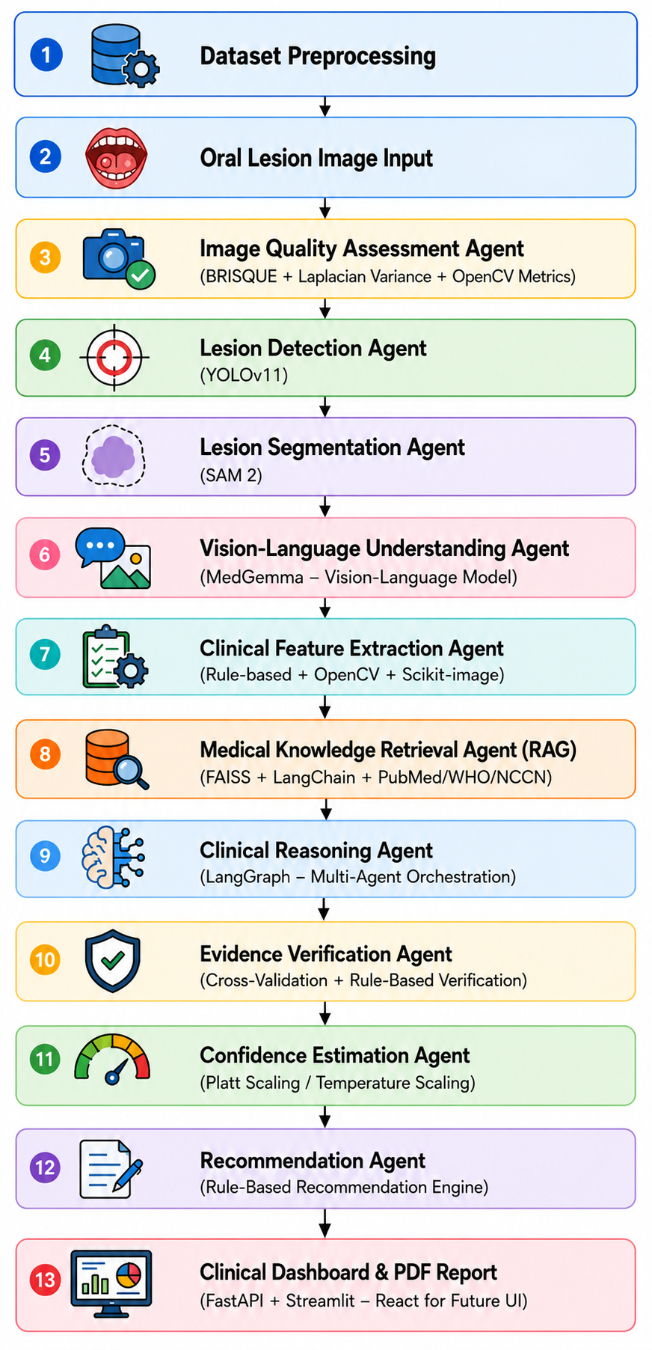
ARCHITECTURE DIAGRAM

Slide 10
MODULES OF THE PROJECT
Image Quality Assessment Module
Lesion Detection Module
Lesion Segmentation Module
Vision-Language Understanding Module
Clinical Feature Extraction Module
Medical RAG Module
Clinical Reasoning Module
Evidence Verification Module
Confidence Estimation Module
Recommendation Module
Dashboard Module

Slide 11
THANK YOU!

